Slide 1
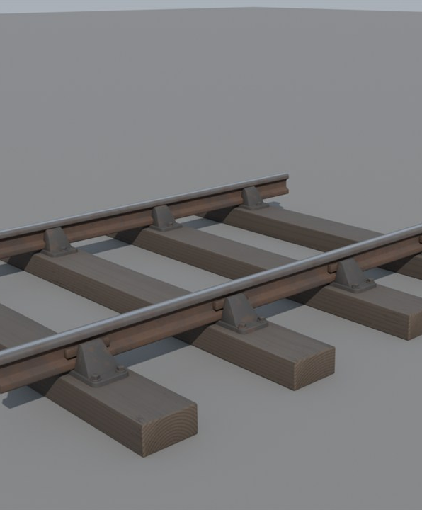
How the Mod Is Balanced
Why steam is cheap to start, and what keeps it from being too easy.
Early Locomotion project render (visual development, not final art).

Slide 2
How to read this guide
Decided.
AGREED
Suggested, not confirmed.
PROPOSED
A test number that may change.
PROVISIONAL
Still an open question.
UNDECIDED
A real-world fact.
BACKGROUND
Every idea carries a tag in the top-right corner.
2

Slide 3
Cheap to start
AGREED
Cost to build
Effort to run
Not to scale
Early rail is cheap and easy to build. The challenge is running it.
3

Slide 4
Cheap track and trains
AGREED
Iron plate
Steam train
Track
Iron rod
Exact recipes: undecided (OQ02)
Electric train
Track is made from iron plates and rods. Trains cost less than the game's own.
4

Slide 5
Long pieces, few clicks
AGREED
One long piece
Many short pieces
Track can be laid in long pieces. The challenge is the trains, not the clicking.
5

Slide 6
A 150 metre experiment
PROPOSED
?
150 m
OQ02
A 150 metre piece limit is only an experiment. It may not work.
6

Slide 7
Every transport has a job
AGREED
Belts: permanent short and medium links
Tractors: flexible, little infrastructure
Steam: early long-distance bulk
Electric: mature speed and throughput
Belts, tractors, steam and electric rail each have a job. Electric leads when the factory matures.
7

Slide 8
Pick the right engine
AGREED
Struggles
Wasteful
Fits
Pick the engine for the load. A big engine on one wagon wastes effort.
8

Slide 9
How engines may feel
PROPOSED
Small
Medium
Large
A few wagons, confidently; struggles on hills
Speed and range; burns more
Heavy hauling; slow to speed up; thirsty
Shape only. Not measured.
Exact curves: undecided
Small is nimble, Medium is quick, Large is strong. These are ideas about their character.
9

Slide 10
The speed question
UNDECIDED
Earlier idea
Later idea
Speed
Speed
?
Small
Medium
Large
Small
Medium
Large
Not to scale
OQ05
Is Medium the fastest, or Large? That is still undecided.
10

Slide 11
How big is a wagon?
PROVISIONAL
A stack is a pile of one item.
Steam wagon: about 20 stacks
Vanilla wagon: 32 stacks
Wagon catalogue: undecided (OQ07)
Steam wagons are cheaper and hold less. About 20 stacks against 32 in a vanilla wagon.
11

Slide 12
Judge the whole route
AGREED
Cost
Cargo per trip
Journey time
Coal and water
Time stopped
Track used
Tender weight
Station size
A good route is judged as a whole, not by one number.
12

Slide 13
Stops cost time
AGREED
Reliability
Short stop
Long stop
Time
To be tested
Service stops trade time for reliability. Whether top-ups help throughput is still to be tested.
13

Slide 14
Test targets for range
PROVISIONAL
Route-dependent targets
Water
Coal
Small
2–3 km
4–5 km
Medium
4–5 km
about 7 km
Large
6–7 km
about 10 km
Not guaranteed distances or tank sizes.
Test targets for range per tank. They depend on the route and may change.
14

Slide 15
Behind the scenes
PROPOSED
Shared base: fuel, water, traction, steam, signals
Data card: numbers for this engine
Model: look, wheels, sound
How it is built: undecided
One shared base could run every steam engine. Each engine is described by data.
15

Slide 16
Where this stands
PROVISIONAL
Test engine on the game's rails
Cost and recipes
Range tuning
Play-testing
Under way
Planned
Planned
Planned
Plans can change.
Balance is a plan. It will be tested and tuned by playing.
16

Slide 17
Still undecided
UNDECIDED
UNDECIDED
UNDECIDED
UNDECIDED
UNDECIDED
Recipes and costs (OQ02)
Longest track piece (OQ02)
Is Medium the fastest? (OQ05)
Engine curves (OQ05)
UNDECIDED
UNDECIDED
UNDECIDED
UNDECIDED
Wagon list (OQ07)
Which fuels work? (OQ08)
Station size (OQ09)
Service stop rules (OQ11)
These questions are open. Nothing here has been chosen yet.
17

Slide 18
Image credits
Slot | Slide | What it shows | Credit
R02 | 1 | Render of the mod's two-rail track. | Early Locomotion project (visual development, not final art).
This deck uses no photographs.
18

